Slide 1
Manual Testing
Manual Testing is a kind of software testing in which a software tester develops and executes the test cases without using any automated testing tools. The main objective of manual testing is to detect the issues, bugs, and defects of a software application.

Slide 2
What is a Software?
Software is a collection of programs to help us to perform a Task.

Slide 3
What is Testing?
Software testing is a part of the Software Development process.
It is an activity to detect and identify the defects in the software.
Reason to test the product is to provide Quality Software.

Slide 4
Types of Software:
Device Software
Programming Software
Application Software.

Slide 5
Device Software
Whenever we want to connect a Hardware device to our windows they didn’t recognize without drivers.
Ex: Drivers, Operating system , Utilities.

Slide 6
Programming Software
Compilers act as translator which convert high level language to low level language i.e. Binary codes (010101).
Ex: Compilers, Debuggers, Interpreters.

Slide 7
Application Software.
Here in Application software we have 3 types.
Web Application
Mobile Application
Desktop Application

Slide 8
Web Application
The applications which are run through web browser is called web applications.
Ex: amazon ,flip kart, myntra ,snap deal.
These can be tested by automation.

Slide 9
Mobile Application
The applications which are run through mobile is called Mobile applications
Ex: what's app, Facebook, amazon prime, Netflix, Instagram, etc.
These cannot be tested by automation.

Slide 10
Desktop Application
The applications which are internally in build is called desktop applications
Ex: paint, calculator, calendar, Ms-office, Ms-word, etc.
These applications cannot be tested.

Slide 11
Software Quality
Bug-free
Delivered on time
Within Budget
Meets Requirements and Expectations
Maintainable

Slide 12
Why Software has Bugs?
Miscommunication or No Communication
Software Complexity
Lack of Skilled Testers
Requirement Changes
Programming Errors

Slide 13
BUGS
Miss communication or No communication: It might be from client to business analyst (or) developer to tester.
Software Complexity: There should be a proper communication between all the developed Languages.
Lack of Skilled Testers: Tester should test in Multiple Test Cases.
Requirement Changes: Once Application is ready client want to make some changes to add another module. so, there are several chances that previous module may effect.
Programming Errors: It is a Developers Mistake.

Slide 14
Why Testing is Required?
To deliver the Quality product to the Client .

Slide 15
PRODUCT BASE COMPANY?
These Applications are used by all kinds of customers.
Ex: Google, Microsoft, Wipro.

Slide 16
PROJECT BASE COMPANY?
These applications are developed for particular customers.
Ex: Accenture, Capgemni, Marolix, TCS, Infosys.

Slide 17
SDLC (Software Development Life Cycle)
Planning
Planning
Analysis
Design
Implementation
Testing
Maintenance

Slide 18
SDLC
Software Development Life Cycle is a process used by a software industry to design, develop and test the Software.

Slide 19
Planning
They will check to build a software how many languages required.
Is there skilled developers if not they will recruit.
Business analyst will involve here and they approach to the Client.

Slide 20
Analysis
Here Project Manager will involve.
PM will estimates the time duration and budget.
Once the budget and time duration is ok for the client then only we will move to next phase.

Slide 21
Design
Here web designers are involved.
(UI/UX)
Languages are (HTML,CSS)

Slide 22
Development
Here developers will involve and they develop the software.
Languages are (JAVA,PYTHON,C++,.NET,C#)

Slide 23
Testing
Tester will start testing the Application here testers will involve.

Slide 24
Maintenance
Once the Application is ready and it is Stable with out Any Issues.
The Build will be released.
Here Developers are involved.

Slide 25
Types of Models
Water Fall Model.
Spiral Model.
V-Model.
Hybrid Model.
Agile Model.

Slide 26
WATER FALL MODEL
It is old and traditional model.
Water fall model is the base model of SDLC and all the models are derived from it.
We cant change the Requirements.
There are 6 phases in this model.
It is used in 90’s.

Slide 27
Flow chart
Design
Requirements
Design
Development
Testing
Deployment
Maintenance

Slide 28
Requirements
Business analyst and project manager will involve and check the documents and they will decide the Budget, they will check whether developers are available are not then they will start Design.

Slide 29
Design
Here designers are involved (UI,UX) they will design the application.

Slide 30
Development
Here developers are involved they develop the application.

Slide 31
Testing
Here testers are involved they will test the software.

Slide 32
Deployment
Here devops engineer are involved.

Slide 33
Maintenance
Here developers and data base analyst are involved.

Slide 34
Advantages of Water fall model
Quality of the Software will be Good.
Requirement Changes are not allowed so the chances of finding Bugs will be less.
Initial investment will be fewer because testers will be hired once Developing is done.
Preferred for small projects.

Slide 35
Dis-advantages of Water fall model
Requirement changes are not allowed.
If there is a defect in Requirement that will be continued at Later Phases only.
Testing will start after coding .

Slide 36
SPIRAL MODEL
To over come the problems which we have in water fall model, spiral model is developed.
It is also called as Iterative Model (Version control Model).
In every cycle New software will be released to the customers.
Software will be released in multiple versions. So called version control model.
We follow the spiral model whenever there is dependency on the module.

Slide 37
Flow chart
Planning
Requirements
Gathering
Risk analysis
Prototype
5
6
1
2
4
3
7
8
Execution engineering
Design
Development
Testing
Evaluation
Project Evaluation

Slide 38
Planning (Requirement Gathering)
Here it is First stage.
Here we Gather information from the client.
Here Budget, developers are available are not will be checked.
Here Business analyst and project manager will be involved.

Slide 39
Risk analysis (Prototype)
Here they will check the Duration , According to the Requirement whether they will release the software in a given time are not.

Slide 40
Execution engineering (Design, Development, Testing)
Here in 3rd stage Design, Development, Testing will be done in single stage.
Here designers, developers, testers will be involved.
Here they will design, they will develop and they will test the Build.

Slide 41
Evaluation
It is the Final output.
Once testing is done they will release the software.
Here client side experts will test the software.

Slide 42
Advantages of Spiral Model
Testing is done in Every Cycle before going to the next cycle.
Customers will get to use the software of every module.
Requirement changes are allowed after every cycle.

Slide 43
Dis-Advantages of Spiral model
Every cycle of the spiral model looks like a waterfall model.
Requirement changes are not allowed in the middle of the cycle.
There is no testing in requirement & design phase.

Slide 44
V-model
Here its shape looks like “v” so called v-model.
Here two life cycles are there
1)Developers life cycle.
2)Testers life cycle.
There are Two Phases.
1)Verification phase.
2)validation phase.

Slide 45
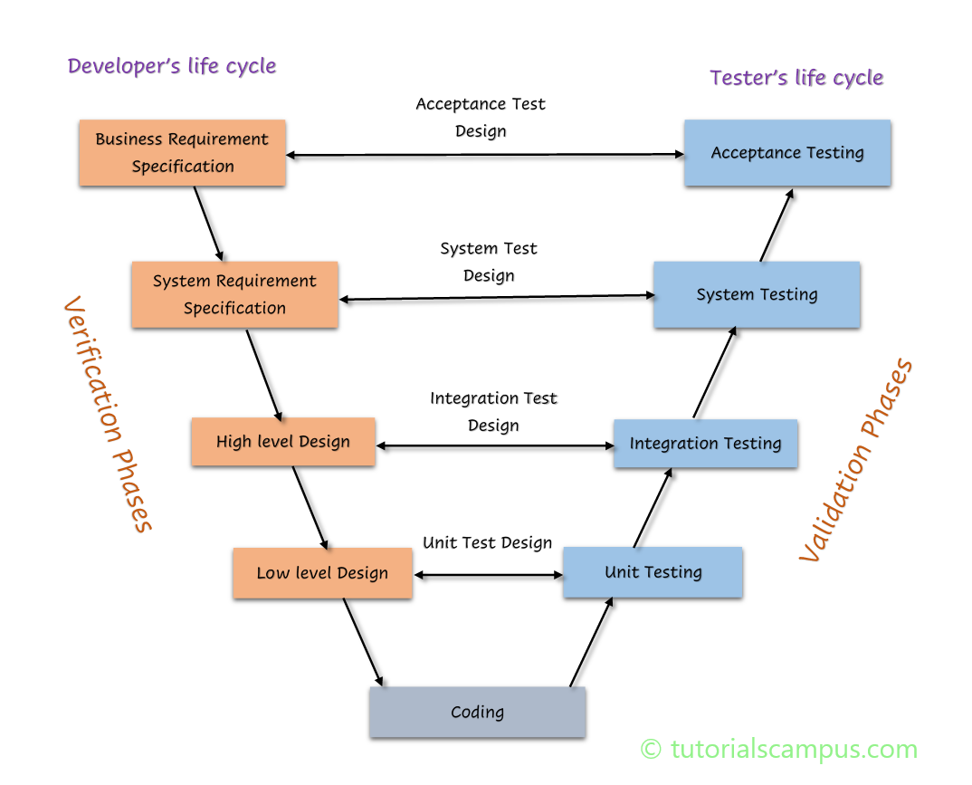
Flow chart

Slide 46
Verification phase Business Requirement Specification
According to the client requirement they will take and they will check whether developers are available are not.
They will prepare a document and review the document.
Here document which is prepared will not be understand by designers.
Here business analyst are involved.

Slide 47
Verification phase System Requirement Specification
Here project Manager will involve.
Here documentation will be converted to easy understand to the designers.

Slide 48
High-level design(HLD) Low-level design(LLD)
In both the phases designers will be involved.
Main page will be HLD.
Sub page will be LLD.
Main page will be designed by high level designers.
Sub page will be designed by low level designers.

Slide 49
Coding
Here developers will be involved.
Developers will develop the software.

Slide 50
Unit Testing
Unit Testing will be conducted on a Single Program or Single Module.
It is White Box Testing Technique.
It will be conducted by the Developers.

Slide 51
Integration Testing
Integration Testing is performed on Several modules.
It is a White box Testing Technique.
It will check the data communication between multiple Modules.
It is done by Developers.

Slide 52
System Testing
Here we will test the over all functionality of the application. whether it was working according to the costumer requirement are not.
Here testers are involved.
Testers will test the software.

Slide 53
User Acceptance Test(UAT)
Here client side experts will involve and perform the testing.

Slide 54
White Box Testing
Unit testing and Integration testing together we call as white box testing.
Here Developers will perform the Testing.

Slide 55
Black Box Testing
System testing and user acceptance testing together we call as black box testing.
Here testers will involve.

Slide 56
Advantages of V-model
Testing is involved in each stage.

Slide 57
Dis Advantages of V-model
Documentation is more.
Initial investment is more.

Slide 58
Verification (static verification)
Verification checks whether we are developing the correct product or not.
Focus on Documentation.
Reviews
Walkthroughs
Inspections
Here only documents are tested.

Slide 59
Validation (dynamic testing)
Focus on Software only.
Actual Software is tested.
Unit Testing, Integration, System Testing, UAT Testing.

Slide 60
Static Testing (Verification) Review:
Conducts on the documents they should be correct & complete. (One or Many)
1) Requirement Reviews
2) Test Plan Reviews
3) Test Cases Reviews
4) Design Reviews

Slide 61
Walkthrough
It is an informal Review ( two or three people will be involved)
Author reads the documents or code and discuss with the Team Members.
It is not Pre-planned and can be done anytime.
Particular duration is not defined.

Slide 62
Inspection
It is a formal review (contains several people)
Inspection will be scheduled at the proper time.
Here 3 people ( Reader, Writer, Moderator) are the main persons.

Slide 63
Incremental Integration
Incrementally adding the modules and testing the data flow between the modules.
Approaches are
Top Down
Bottom Up

Slide 64
Top down
Adding the modules, testing the communication between the modules and checking child module is added to the previous module.
Select a phone
Adding address
Payment

Slide 65
Bottom up
Adding the modules, testing the communication between the modules and checking parent module is added to the previous module.
Select a phone
Adding address
Payment

Slide 66
System Testing
There are 4 categories
GUI ( graphical user interface ) Testing
USABILITY TESTING
Functional Testing
Non-Functional Testing

Slide 67
GUI (graphical user interface)
Testing the user interface of the application.
It includes elements such as Buttons, colors, fonts, icons, sizes.

Slide 68
USABILITY TESTING
It will check how easily the user is able to access the Application.

Slide 69
Functional Testing
It checks the Actual Behavior of the Application.
Functional testing focuses on how your feature will work.
Functional testing Categories are
Object and Properties Testing.
Database Testing.
Error handling Testing.
Calculation and Manipulation Testing.
Links Existence and Links Execution.
Cookies and Session.

Slide 70
1)Object and Properties Testing.
Check the properties of the objects present on the Application are not.
Ex: Enable, Disable, Visible.

Slide 71
2)Database Testing
Data base is an organized collection of structured information (Storage Location) A database.

Slide 72
3)Error handling Testing.
Tester verifies the error message while performing incorrect action on the application.
It should be readable in simple language.
Incorrect are Invalid data.

Slide 73
4)Calculation and Manipulation Testing.
Tester should check the calculations.

Slide 74
5)Links Existence and Links Execution.
Where exactly the links are placed links are Navigating to proper page.

Slide 75
6)Cookies and Session.
Cookies are temporary files created by the browser.
Sessions are used for security purpose.
Ex: In banking application when the page is not used for certain time it will expire.
Tester will check whether its log outing on given time period are not.
Testers will check whether cookies are creating are not.

Slide 76
Non-Functional Testing
Once the Application is working according to the requirement will we will start Non-Functional Testing.
It will focus on Load and Security
It has 6 categories.
Performance Testing
Security Testing
Recovery Testing
Compatibility Testing
Installation Testing
Garbage/Sanitation Testing

Slide 77
1)Performance Testing
LOAD: Increasing the load on the application gradually and checking the speed.
STRESS: Increasing/Decreasing the load on the Application Suddenly.
VOLUME: It will check how much data is able to handle.

Slide 78
2)Security Testing
To check how secure our application.
Authentication: Users are valid or not.
Authorization /Access Control: Permissions of the Valid User.

Slide 79
3) Recovery Testing
Check the System change from abnormal to Normal.

Slide 80
4)Compatibility Testing
Forward Compatibility -- Previous software with latest mobile.
Backward Compatibility -- Latest software with old mobile.
Hardware Compatibility (Configuration Testing) – whether all systems are capable to use this application are not.

Slide 81
5)Installation Testing
Check Screens are clear to understand
Screens navigation
Simple or not
Un-installation

Slide 82
6) Sanitation / Garbage Testing
If any application provides extra features/functionality then we consider it as a Bug.

Slide 83
Functional Vs Non-Functional
Functional
Non Functional
Validates the functionality of Software .
Functionality describes what software does.
Concentrates on user requirement .
Functional testing takes place before Non-functional testing.
Verify the performance, Security, Reliability of the software.
Non-Functionality describers how software works.
Concentrate on user expectation.
Non-Functional testing performed after finishing Functional testing.

Slide 84
UAT(User Acceptance Testing)
It will be done in customers environment before releasing the Application.
It will be conducted by client.

Slide 85
Regression Testing
Testing conducts on modified modules to make sure that there will not be an impact on functionality because of changes like adding/deleting/modifying features.
There are 3 categories.
Unit Regression Testing.
Regional Regression Testing.
Full Regression.

Slide 86
1) Unit Regression Testing
Testing only the changes/modifications done by the developer.

Slide 87
2) Regional Regression Testing
Testing the modified along with the impacted modules.

Slide 88
3) Full Regression
Testing the main feature and remaining part of the application.

Slide 89
Re-Testing
If the developer fixes the bug, Tester will test the impacted area which is called Re-testing.
Tester closes the bug if it is fixed.
If not they reopen the bug and sent it back to the developer.

Slide 90
End to End Testing
End-to-end testing is a type of software testing that tests flows from beginning to end, as opposed to only testing individual steps

Slide 91
Smoke Testing
In this testing method, the development team deploys the build in QA. A subset of test cases are taken, and then testers run test cases on the build. The QA team test the application.
Both developers and testers will do the smoke testing.

Slide 92
Sanity Testing
Sanity testing is a type of regression testing used in quality assurance. The main purpose of sanity testing is to make sure that the proposed modifications or functionality works as intended.
Testers are involved.

Slide 93
Smoke Vs Sanity
Smoke
Sanity
Smoke test is done to make sure the build we received from the development team is stable or not.
Smoke Testing is performed by both Developers and Testers.
Build may be either stable or not.
It is done in beginning.
It will be done every time if there is a new Build release
A sanity Test is done during the release phase to check for the main functionalities of the application.
Sanity testing is performed by testers alone.
Sanity testing is done if the build is stable.
It is done once the application is stable.
It is planned when there is not enough time to do it.

Slide 94
Exploratory Testing
Testers have to understand completely and test it.
It will be done when the application is ready but there is no requirement

Slide 95
Drawbacks of Exploratory Testing
The tester might misunderstand any feature as a bug as a feature since you do not have requirements.
Time-consuming
If there is any bug in the application, the tester is unable to identify it.

Slide 96
Adhoc Testing
Testing application randomly without any test cases (or) any business requirement document.
Adhoc testing is an informal testing type.
Tester should have knowledge of the application even though he doesn’t have the requirements.
Tester is usually on unplanned activity.

Slide 97
Monkey testing
Testing applications randomly without any test cases or any business requirement document.
It is informal
Tester does not have knowledge of the application.

Slide 98
Exploratory vs Adhoc vs Monkey
Exploratory
Adhoc
Monkey
No Documentation.
No plan.
Formal Testing.
Testers doesn’t have knowledge on the functionality.
Random Testing.
Intention is to learn or explore the application.
Any Applications which is new to the Tester.
No Documentation.
No plan.
Informal Testing.
Tester should know the Application functionality.
Random Testing.
The intention is to break the application.
Any Applications.
No Documentation.
No plan.
Informal Testing.
Tester should know the Application functionality.
Random Testing.
The intention is to break the application.
Any Applications.

Slide 99
Positive Testing
Testing the application with valid inputs is called positive Testing

Slide 100
Negative testing
Testing the application with invalid inputs is called Negative Testing.

Slide 101
Globalization & Localization
Globalization Performed to ensure the system or Software application can run in any culture and any environment.
Localization is Performed to check system application is designed for specific region.

Slide 102
ALPHA VS BETA TESTING
Alpha Testing
Beta Testing
Alpha testing will be performed by Testers who are usually internal employees of the organization.
Alpha testing performed at the developers end.
Alpha testing involves both the white box testing and black box testing.
A long execution cycle required for the alpha testing.
Critical issue or fixes can be addressed by developers immediately in Alpha testing.
Beta testing is performed by the client are End users who are not employees of the organization.
Beta testing is performed at the client location.
Beta testing typically uses Black box testing.
Only few weeks of execution are required for Beta testing.
Most are the issues/feedback is collected from beta testing will be implemented in future version of the product.

Slide 103
Test Design Techniques
To reduce the test cases and also save the time.
Here we have 5 Techniques
Equivalence Class Partition
Boundary Value Analysis
Decision table
State transition
Error Guessing

Slide 104
1)Equivalence Class Partition
Dividing data into various classes and we can select the data according to requirements.

Slide 105
2)Boundary Value Analysis (BVA)
Boundary Value Analysis(BVA) Technique is used to check Boundaries of the input.

Slide 106
3)Decision Table
A decision table is also called a cause effect table.
This technique will be used if we have more conditions and corresponding actions.
To identify the test cases with decision table we consider conditions and actions.

Slide 107
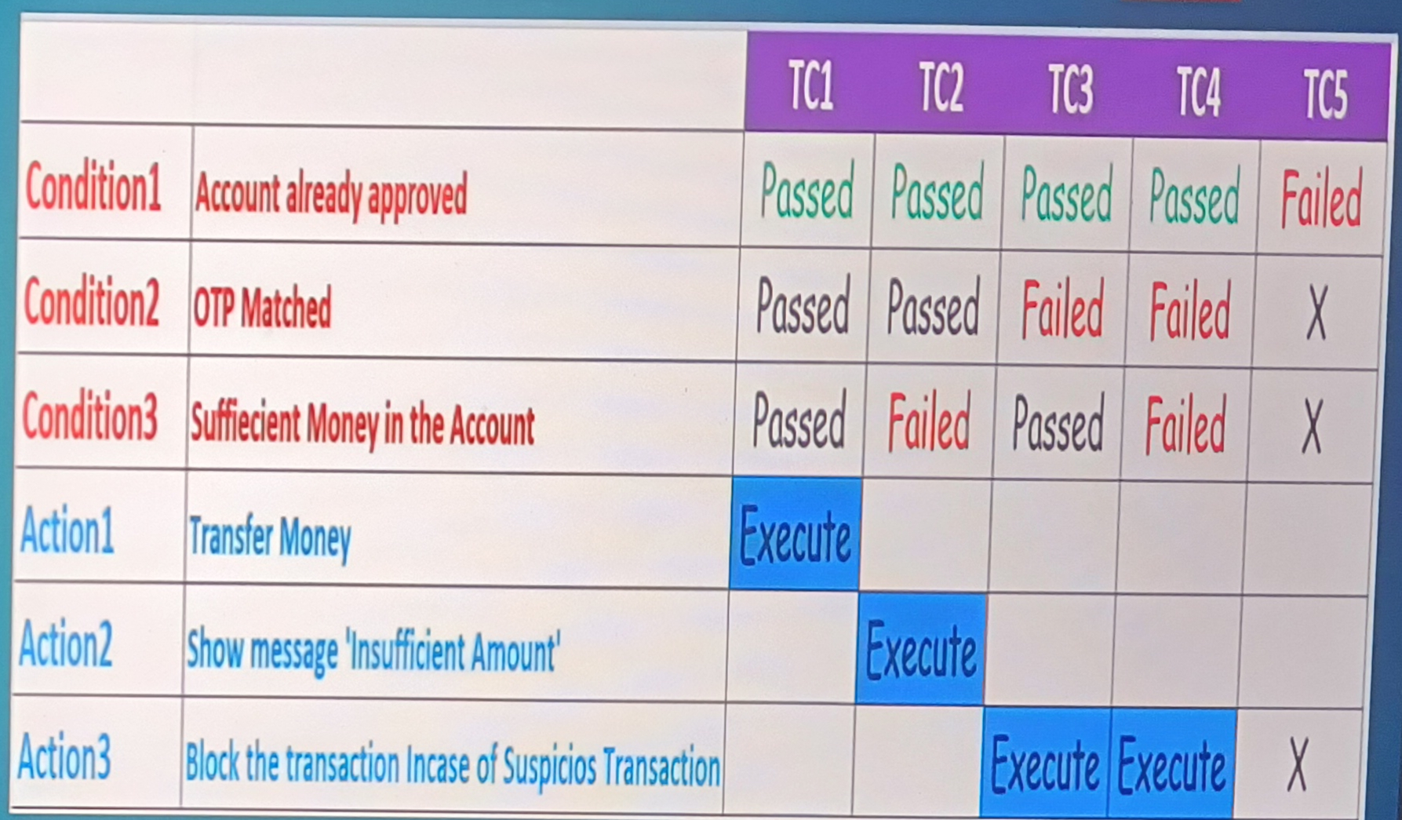
Example of Decision Table

Slide 108
4) State Transition
It is changing the condition from one state to another .
This testing technique allows the tester to test the behavior of the Application.
Tester can perform this action by entering various input conditions in a sequence.

Slide 109
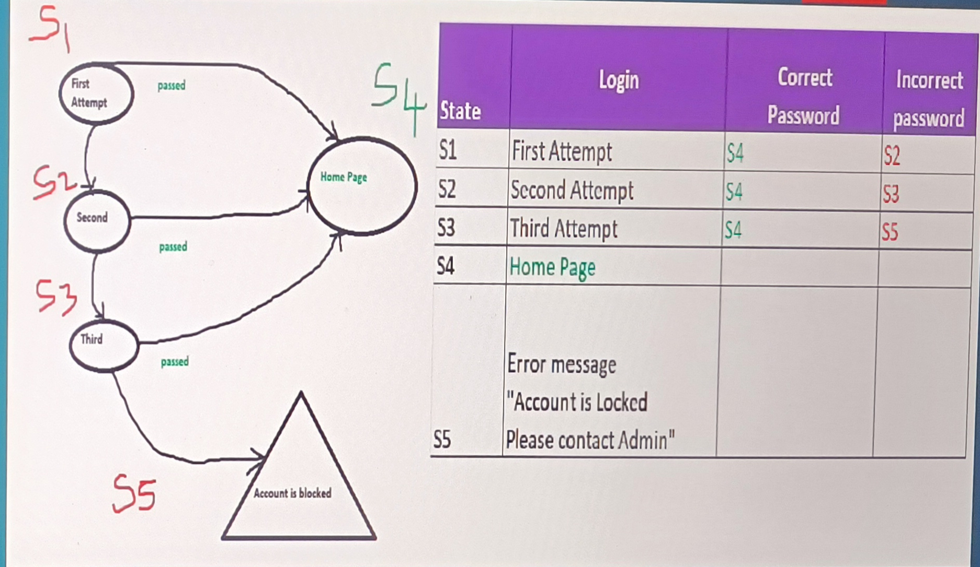
Example of state decision

Slide 110
5)Error Guessing
It is one of the testing techniques used to find bugs in software Application.
In Error Guessing we don’t follow any specific rules.
It depends on Testers Analytical skills and Experience.

Slide 111
SOFTWARE TESTING LIFE CYCLE (STLC)
Flow chart
Requirement Analysis
Test Planning
Test Case Development
Environment Setup
Test Execution
Test Cycle Closure

Slide 112
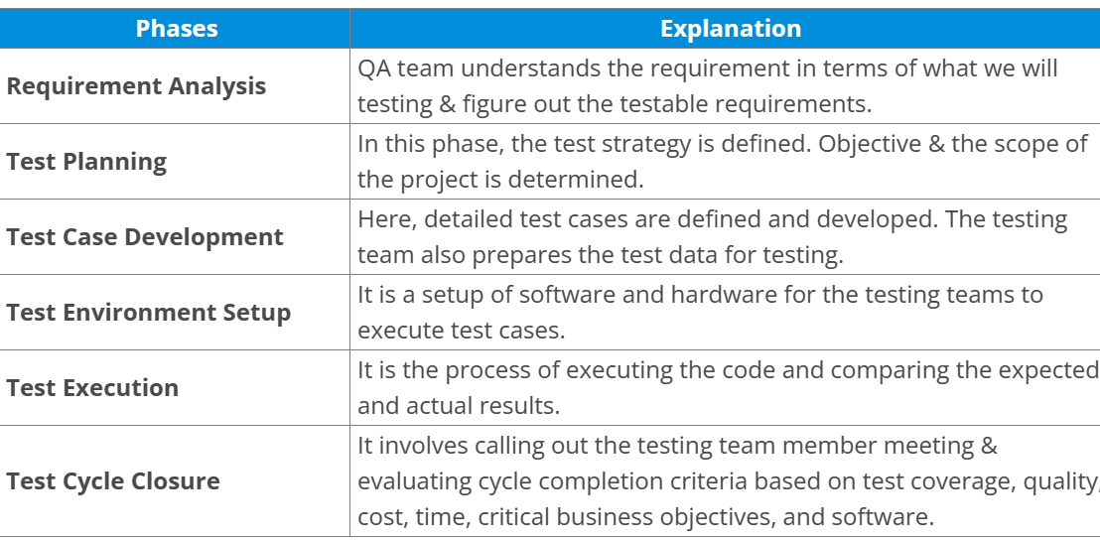
Explanation

Slide 113
Requirement Analysis
Requirement Analysis is the process of determining User Expectations for a new or Modified product and is Vital for Effective QA software testing as it Lays down the Basic foundation for various stages of SDLC.

Slide 114
Test Plan Contents
A Test plan is a document that describes the test scope. Test Strategy, objectives, schedule, deliverables and resources required to perform testing for a software product

Slide 115
Test plan Templates contents
Test strategy
Defect Reporting
Roles/Responsibilities
Test Schedule
Test Deliverables
Entry and Exit Criteria
Suspension and Resumption Criteria
Tools
Risks and Mitigation
Approvals

Slide 116
Meanings of test plan Template contents
Test Strategy - Procedure to test step by step process (Smoke, Sanity and Functional)
Defect reporting - How we will report the Bug through tools
Roles/Responsibilities - (Responsibility of Test Engineer, Test Lead, Author)
Test Schedule - (Duration and Activity) They will do the activity in a certain time period of a certain build
Test Deliverables - Test cases, Test Execution ( Documents) according to the documentation
Entry and Exit Criteria - Where tester have to start and exit
Suspension and Resumption criteria - (If an application is broken need to report it)
Tools – (Bug tracking, Automation tools-selenium, Test Management-exel)
Risks and Mitigation- we will add some more test cases according to the requirement
Approvals- Manager will approve it.

Slide 117
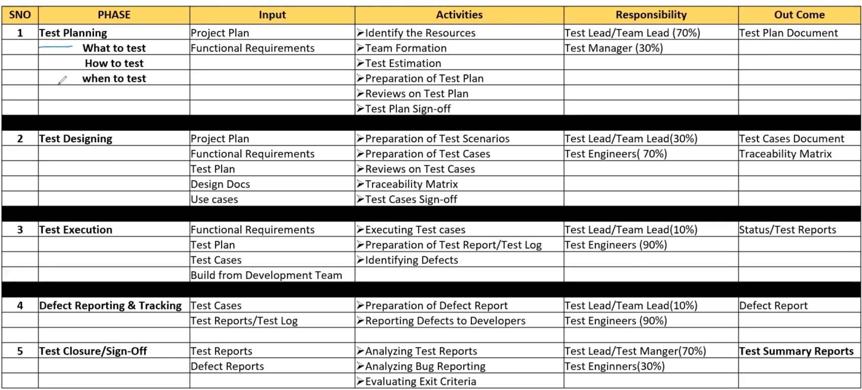
Explanation

Slide 118
USE CASE
Use case describes the requirement containing three items. It will be prepared by Business analyst
Actor- Which user is , interacting with process
Action- Which is the final outcome
Goal- To achieve the correct outcome.

Slide 119
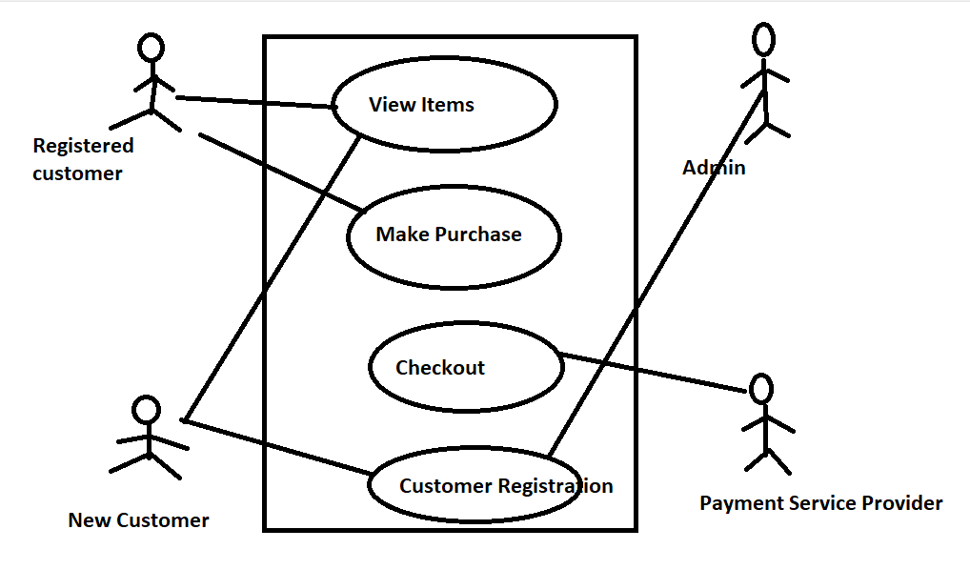
Example of use case

Slide 120
Test Scenario: A Possible area to be tested (What to test) Test case: Step-by-step actions to perform and validate the functionality. Test steps, expected result, Actual result Use case Vs Test Case: use case describes the functional requirement,
prepared by BA ,test case describes test steps prepared by Test Engineer. Test Scenario: What to be tested- How to Test Checking the functionality of the login button Test suite: Group of test cases which belong to the same category.

Slide 121
Requirement Traceability Matrix
RTM describes the mapping of requirements with the Test cases. The main purpose of RTM is to see that all test cases are covered so that no functionality should miss while doing software testing.
Test Execution: The testing team will carry out the testing plans and test cases
Entry criteria: Test cases, Test Data & Test plan Activities: 1) Test cases are executed based on the test planning 2) Status of the test cases are passed, failed and Blocked. 3) Defects are tracked till closure.

Slide 122
Test reporting tools
Defect/Bug If the functionality of the application is not related to the actual exception it is called as Bug. Defect Reporting tools: 1)Clear Quest 2)Dev Track 3)Jira (Bug reporting & Test Management) 4)Quality Centre (Bug reporting & Test Management) 5)Bug Jilla

Slide 123
Severity
Severity: If any defect can affect/impact the particular software it is related to the Severity.
Types in severity
Blocker
Critical
Major
Minor

Slide 124
1)Blocker
This defect indicates nothing can proceed.
Ex: Application crashed, Login not worked

Slide 125
2) Critical
The Basic functionality is not working.
Ex: Unable to add an item Ex: Unable to make the payment

Slide 126
3) Major
It causes some Behavior/feature of the application is still working Ex: No confirmation message

Slide 127
4) Minor
It won’t cause a breakdown
Ex: Spelling, Alignments

Slide 128
Priority
Priority : It describes the importance of the defect
P0(High) : The defect must be released immediately as it affects the system and cannot be used until it is fixed
p1(Medium) : It can wait until a new version/ Build is created
p2 (Low) : Developer can fix it in Later releases.

Slide 129
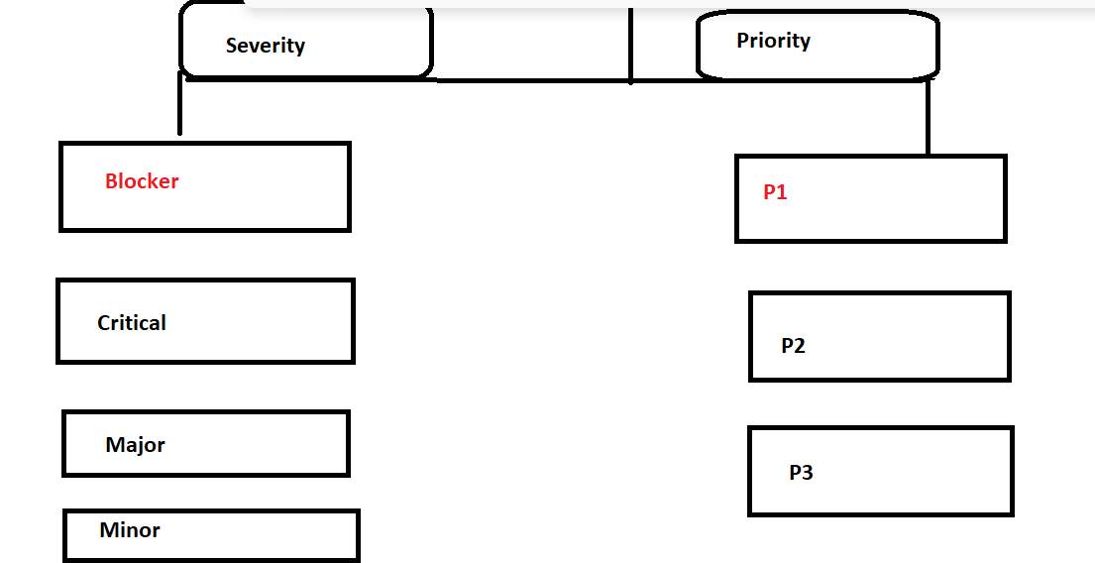
Severity and priority

Slide 130
Examples of
High severity
High priority
Examples of
Low Severity
Low Priority
Examples of
High Severity
Low priority
Examples of
Low Severity
High priority

Slide 131
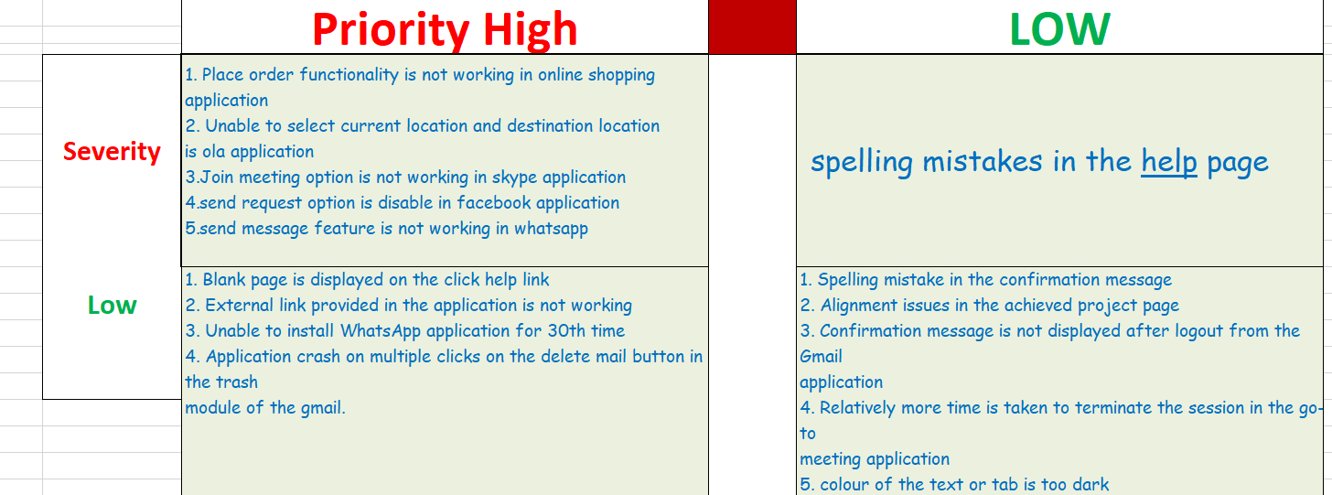

Slide 132
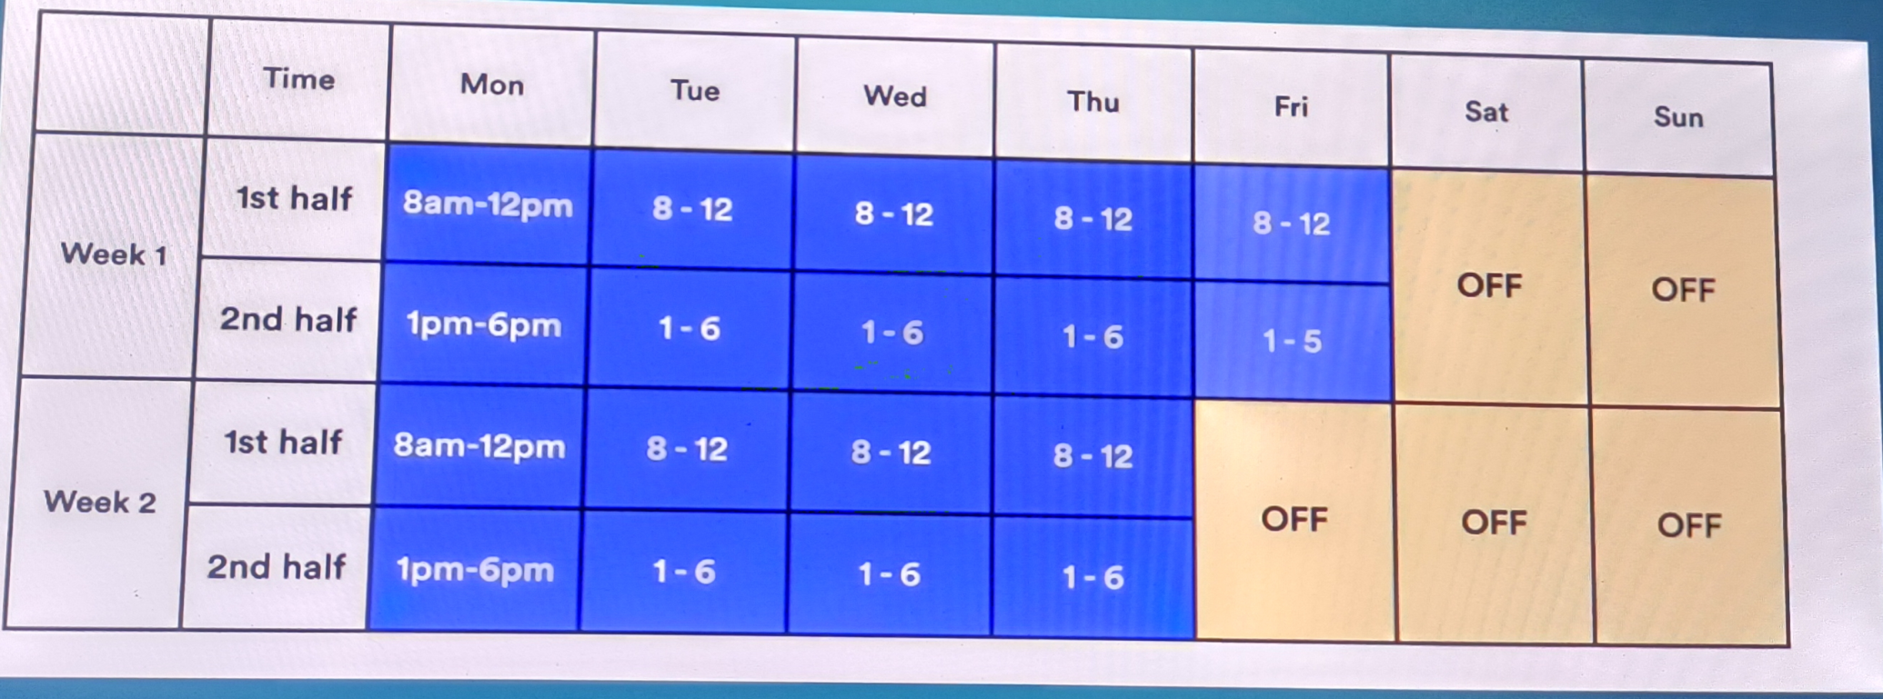
Reliability Testing
Testing the Functionality of an Application for a continues period of time is know as Reliability testing.

Slide 133
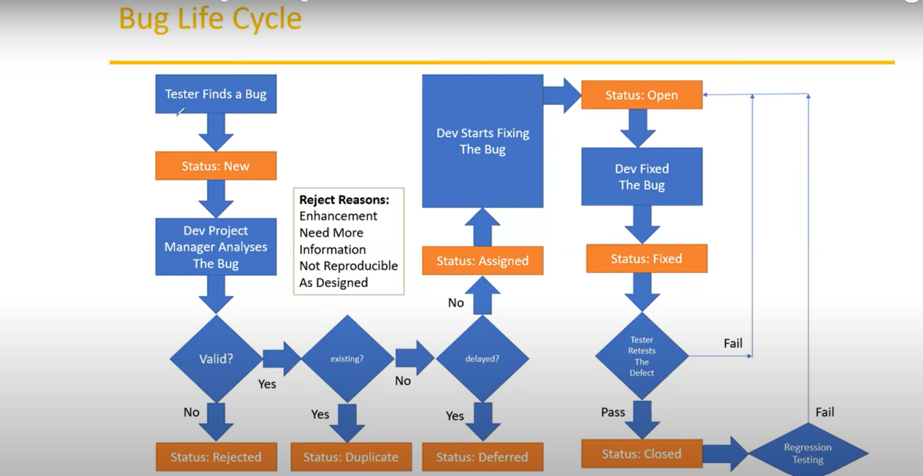
BUG LIFE CYCLE

Slide 134
Rejection Reasons
Enhancement: It will be implemented in later phases.
Need more information: Developing team will accept but they need more information.
Not Reproducible: Not able to find the bug in developers environment.
As Designed: Tester will think it’s a bug but as per client requirement it was working.

Slide 135
Agile method
Agile is a software Development process that happens on an Iterative and Incremental approach.
90% of companies are using Agile method.
It is a combination of Iterative and Incremental.
There are 12 principles in Agile

Slide 136
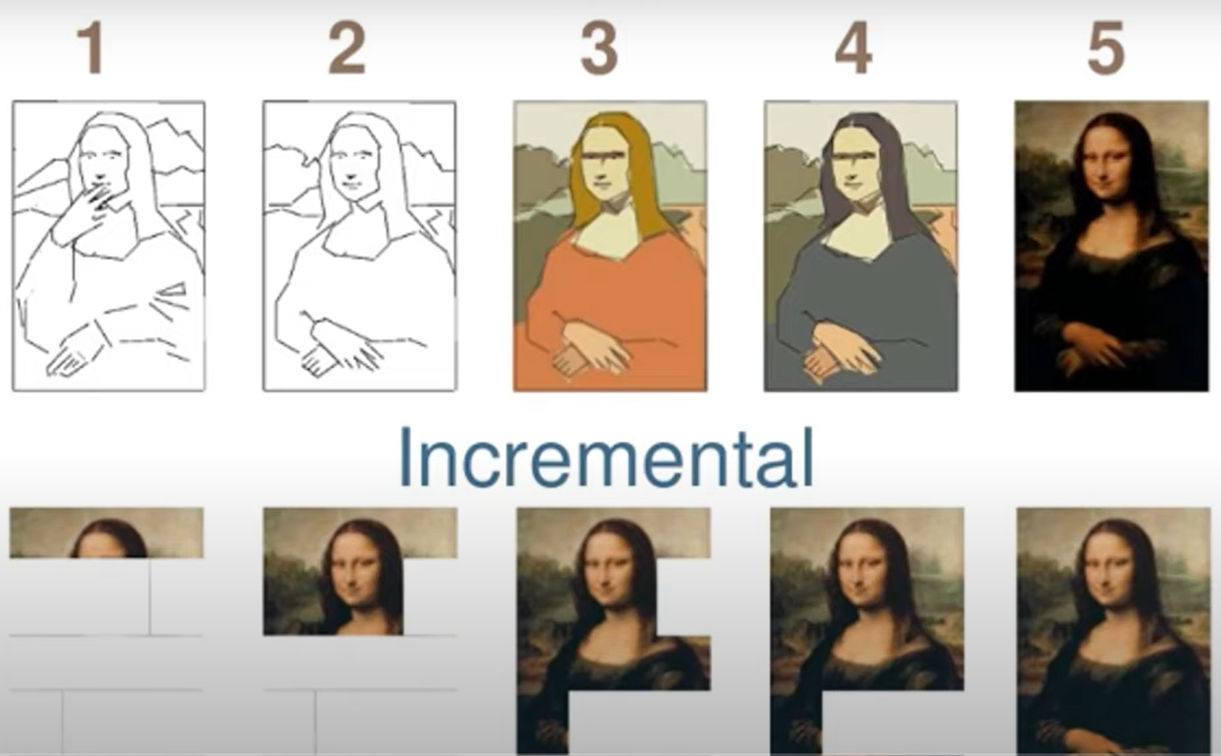

Slide 137
1)Customer Satisfaction
2)Welcome changing Requirements
3)Delivery of working software frequently
4)Work together
5)Trust support
6)Face-to-Face Conversation
7)Working Software
8)Sustainable Development
9)Technical Excellence
10)Simplicity
11)Self Organizing Teams
12)Adjusts

Slide 138
1)Customer Satisfaction
Highest priority is to satisfy the customer through early and continuous delivery.

Slide 139
2)Welcome changing Requirements
We can accept the changes in this process.

Slide 140
3)Delivery of working software frequently
Need to deliver Quality software from a couple of weeks.

Slide 141
4)Work together
Business people and developers must work together daily through out project.

Slide 142
5)Trust support
Build project based on motivated individuals give them the environment and support they need and trust them to get the job done.
Here slum masters are involved.

Slide 143
6)Face-to-Face Conversation
This is most efficient and effective method of conveying information with in a development team. (Less Documentation)

Slide 144
7)Working Software
It is primary measure of progress.
It is a primary goal to developers.

Slide 145
8)Sustainable Development
Sponsors, Developers and user should be able to maintain a constant phase.

Slide 146
9)Technical Excellence
Continuous attention to technical excellence and good design enhances.

Slide 147
10)Simplicity
Make it simple as possible.

Slide 148
11)Self Organizing Teams
Requirements and designs emerge from self organizing team.

Slide 149
12)Adjusts
Team reflects on how to become more effective.

Slide 150
Agile Methodologies
Extreme Programming (XP)
Feature Driven Development (FDD)
Kanban
Scrum
We will use Scrum Methodology

Slide 151
Scrum
Scrum is a frame work through which we build software products by following Agile principles.
These people are involved
Product Owner
Scrum Master
Developing Team
QA (Testers)

Slide 152
Product Owner
Defines the features of the project. (Explain the features of the project)
Prioritize features According to the Market Value. (He will chose the features according to market valve)
Adjust features and priority of every Iteration. (Adjust the Features and check the importance according to the priority)
Accept are Reject work Results.(Accept and reject the modules)

Slide 153
Scrum Master
He will handle the Agile process according to Principles.

Slide 154
Developer
Develops the Application According to the Requirements.

Slide 155
QA(Quality Analyst)/Tester
Tests the application to deliver a Quality product

Slide 156
Scrum Terminology
User Story : A Feature/Module in software.
Epic : Collection of User stories.

Slide 157
Product Backlog:
Contains a List of User stories prepared by the Product Owner.
Sprint:
Period of Time to complete the User stories decide by the product owner and Team, approximately 2-4 weeks of Time.
Sprint Planning Meeting:
Meeting Conducted with in the Team to define What can be delivered in the Sprint and Duration.
Sprint Backlog:
List of stories Created by DEV/QA for a specific sprint.
Scrum meeting:
Scheduled meeting by Scrum Master Every day for 10-15Mins. (scrum call/stand up call)
Sprint Retrospective Meeting:
Conducts Meeting after completing the Sprint. The Entire Team, including Both Scrum Master and Product Owner, should Participate.
Story Point:
Rough estimation of User Stories, will be given by DEV &QA.
Burn Down chart:
Shows how much work remaining in the Sprint. Maintained by Scrum master Daily.

Slide 158
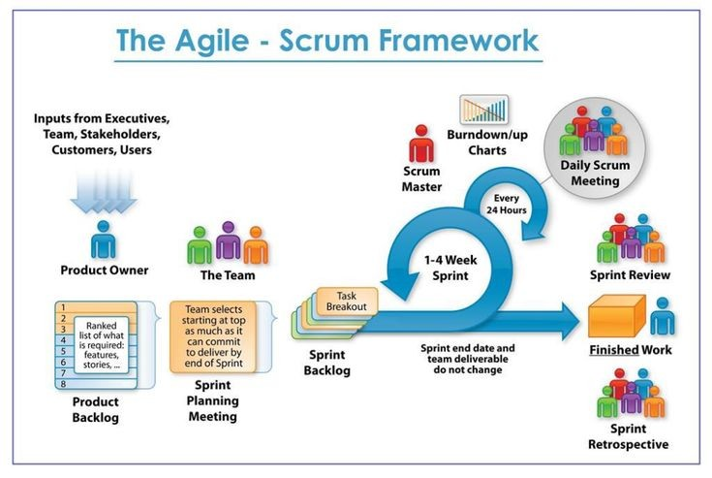
Flow chart

Slide 159
Important points of Agile
Roles
Product owner
Scrum Master
Developer
QA(tester)
Artefacts
Product Backlog
Sprit Backlog
Ceremonies
Sprint Planning
Daily scrum
Sprint Review

Slide 160
Advantages of Agile model
Requirement changes are allowed in any stage of Development.
Release will be very Fast.
Customer no need to wait for Long time.
Good communication between Team.
It is very easy model to Adopt.

Slide 161
Dis advantages of Agile Model
Less focus on design and documentation since we deliver software very faster.

